Slide 1


Title:
Crop Recommendation System
Name : Kinjarapu Rajesh Kumar
Regd No : 12211048
Roll No : 47
Section : K22UG
Date :

Slide 2

Problem Statement
Agriculture is a key sector in India, but farmers often rely on traditional knowledge to select crops.
Problem: Incorrect crop selection due to lack of data-driven insights.
Leads to poor yield, soil damage, and economic loss.

Slide 3

Objective
Build a machine learning model to recommend the most suitable crop.
Based on soil nutrients (N, P, K), temperature, humidity, pH, and rainfall.
Goal: Achieve high model accuracy (>95%) in predicting crop type.

Slide 4
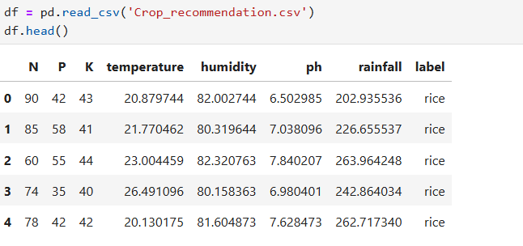
Dataset
Source: Kaggle – Crop Recommendation Dataset
Features:
  N, P, K (macronutrients)
  Temperature (°C), Humidity (%), pH, Rainfall (mm)
  Label (Crop type)
Size: 2200+ rows × 8 columns

Slide 5
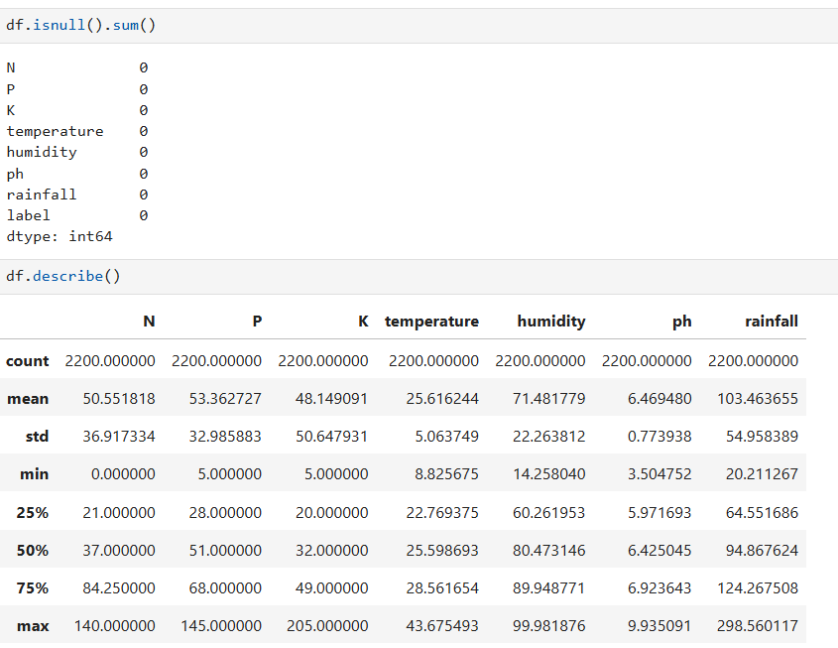
Data Preprocessing
No missing values found.
Applied log transformation on “rainfall” to reduce skewness.
Standardized numeric columns using StandardScaler.

Slide 6
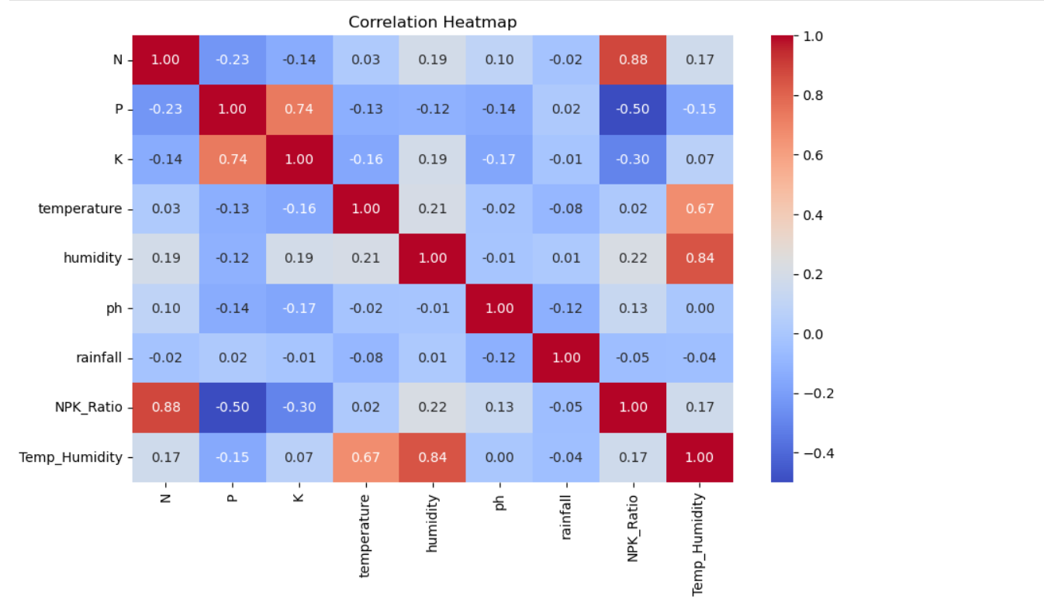
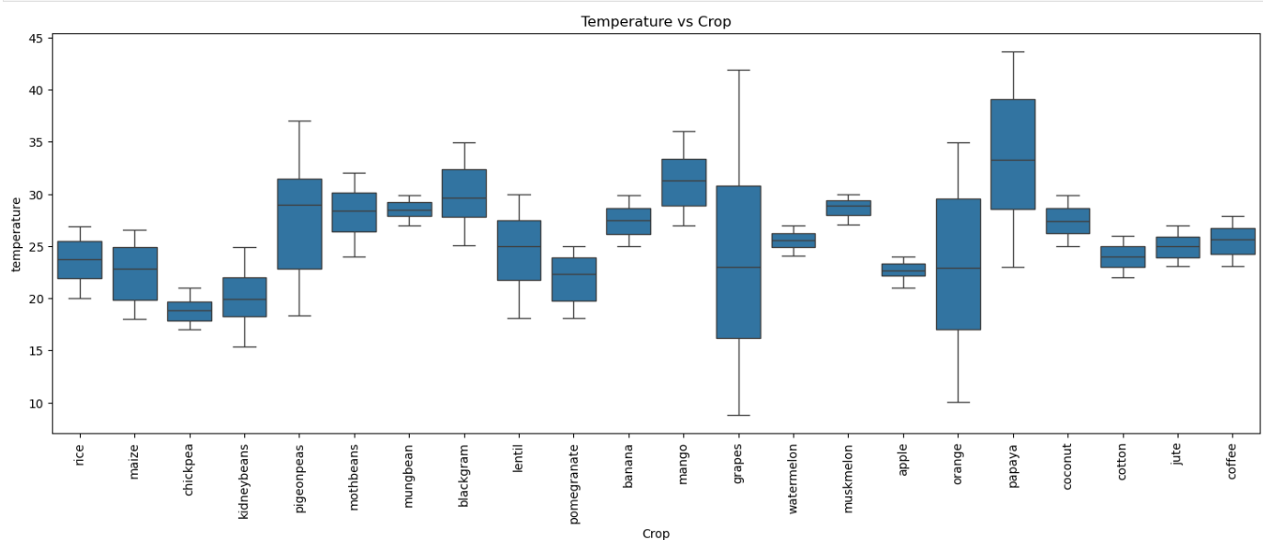
Exploratory Data Analysis (EDA)
Boxplot to identify outliers in numeric columns.
Count plot & Pair plotof each crop type.
Correlation heatmap to understand feature relationships.

Slide 7
Model Selection
Algorithms tried:
  Decision Tree
  Random Forest
  Logistic Regression
  Support Vector Machine (SVM)
Why these?
A diverse mix of models was used to compare performance across different learning complexities.
Decision Tree and Logistic Regression provide fast, interpretable baselines for classification.
Random Forest and SVM handle non-linearity, reduce overfitting, and improve overall accuracy.
All models support multi-class classification, making them suitable for predicting various crops.

Slide 8
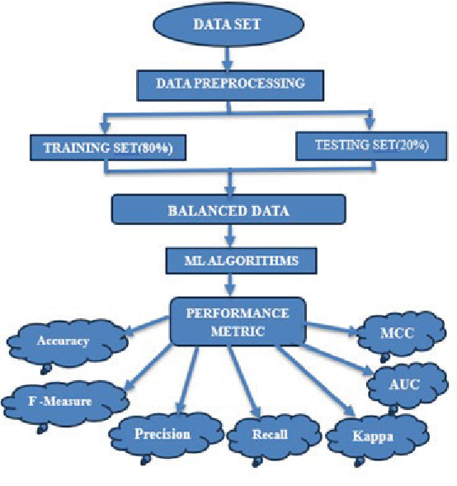
Model Training
Dataset split into train-test (80-20).
No complex tuning, used default or minimal hyperparameters.
Used scikit-learn libraries for all models.

Slide 9
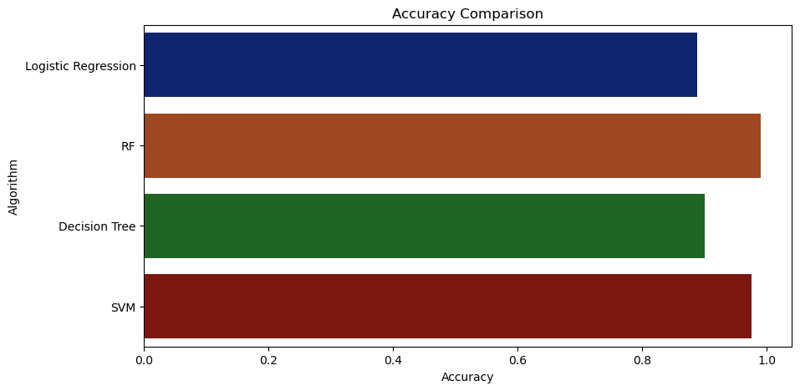
Results and Evaluation
Best Accuracy:
Random Forest – 98%
Evaluation metrics used:
  Accuracy,
  Precision,
  Recall,
  F1-Score

Slide 10
Final Model and Key Findings
Final Model: Random Forest Classifier
Accuracy: 98%, Robust against overfitting.
Highly effective in distinguishing between crop types.
Model maintained stability across cross-validation folds.
Random Forest offered feature importance insights to understand influential parameters.

Slide 11
Challenges Faced
Feature scaling requirement.
Slight imbalance in crop label counts.
Initial confusion between crops with similar conditions.
Similar crop requirements caused overlapping predictions.
Required tuning to balance bias-variance in ensemble methods.

Slide 12
Future Work
Incorporate real-time weather data.
Add soil type and geolocation features.
Build a web/mobile interface for farmers.
Explore satellite imagery for remote sensing-based prediction.
Integrate farmer feedback to improve model adaptability.

Slide 13
Conclusion
Built a high-performing ML model to assist farmers.
Data-driven farming can optimize yield and sustainability.
Future expansion can empower rural agriculture using AI.
Demonstrated practical use of ML in agriculture.
Supports scalable solutions for precision farming.

